Slide 1

Dive in Computer Vision Tensor Flow
Pattern Recognition & Regression
Thu Aug 24, 2021
Kt.Kim

Slide 2
Outline
Back To Basics
Linear Regression - Predict fuel efficiency
Logistic Regression

Slide 3
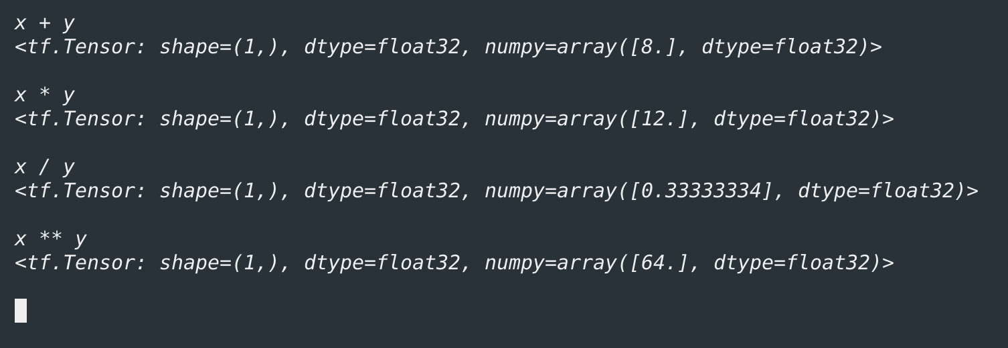
Back To Basics
A scalar is an element of a field which is used to define a vector space
operations with them, namely addition, multiplication, division, and exponentiation

Slide 4
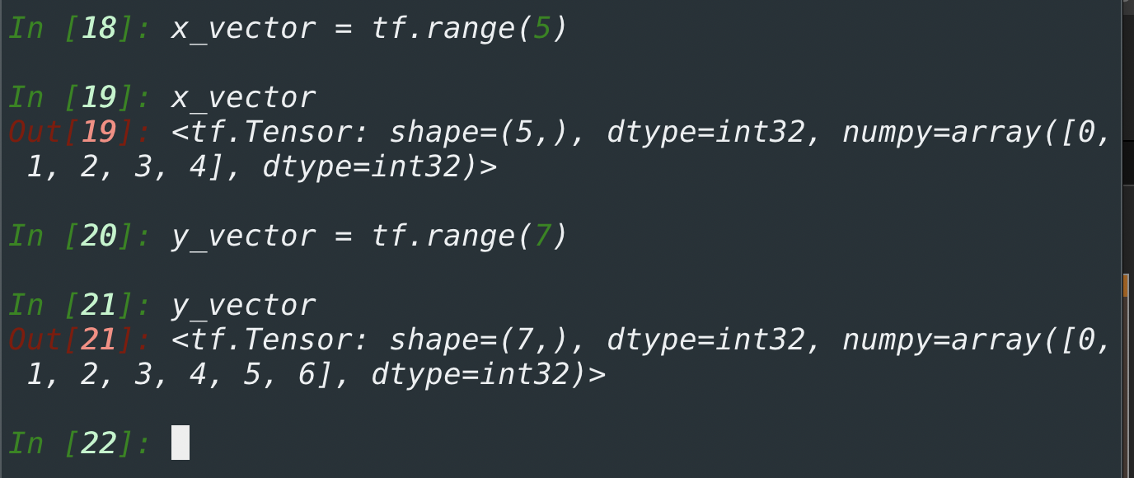
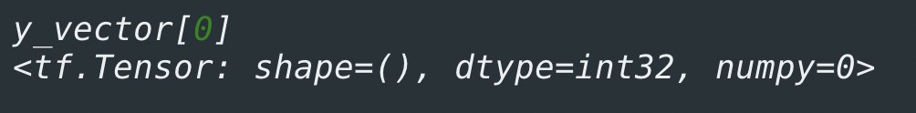
Mathematics for Machine & Deep Learning
A Vector as simply a list of scalar values
where 𝑥1,…,𝑥𝑛, x1,…,x𝑛 are elements of the vector.
we access any element by indexing into the tensor.

Slide 5
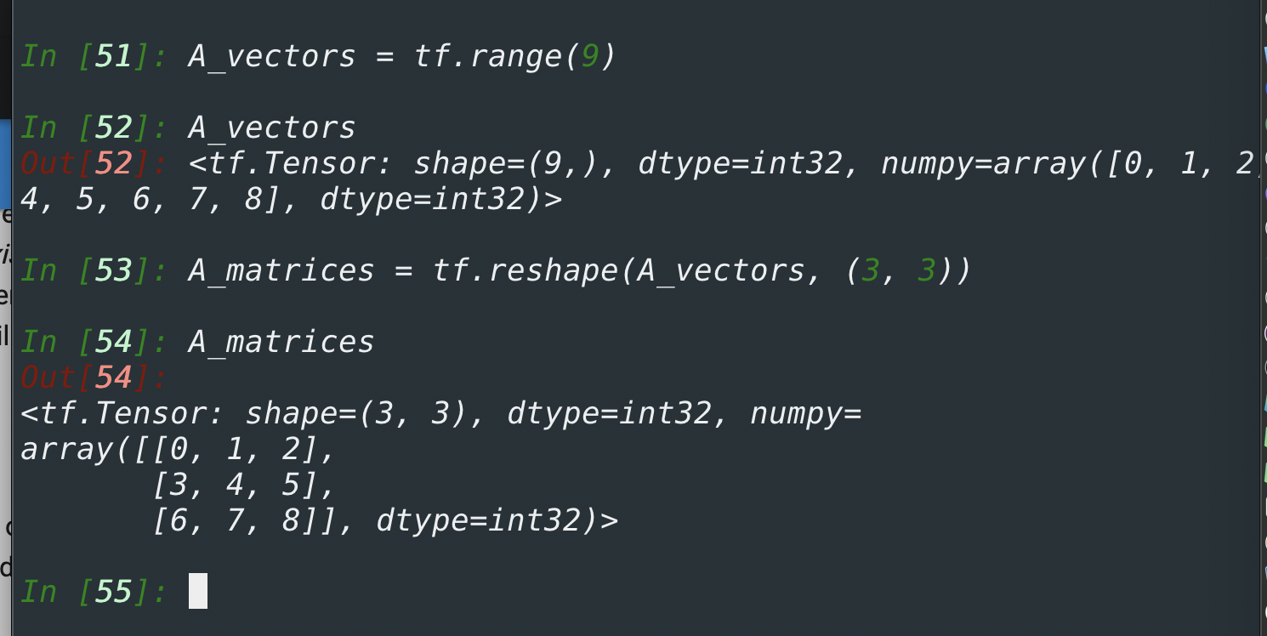
Mathematics for Machine & Deep Learning
Just as vectors generalize scalars from order zero to order one, matrices generalize vectors from order one to order two. Matrices, which we will typically denote with bold-faced, capital letters
e.g., 𝐗 , 𝐘 , and 𝐙 are represented in code as tensors with two axes.

Slide 6
Mathematics for Machine & Deep Learning
Just as vectors generalize scalars, and matrices generalize vectors, we can build data structures with even more axes. Tensor
Tensors will become more important when we start working with images, which arrive as 𝑛 - dimensional arrays with 3 axes corresponding to the height, width, and a channel axis for stacking the color channels

Slide 7
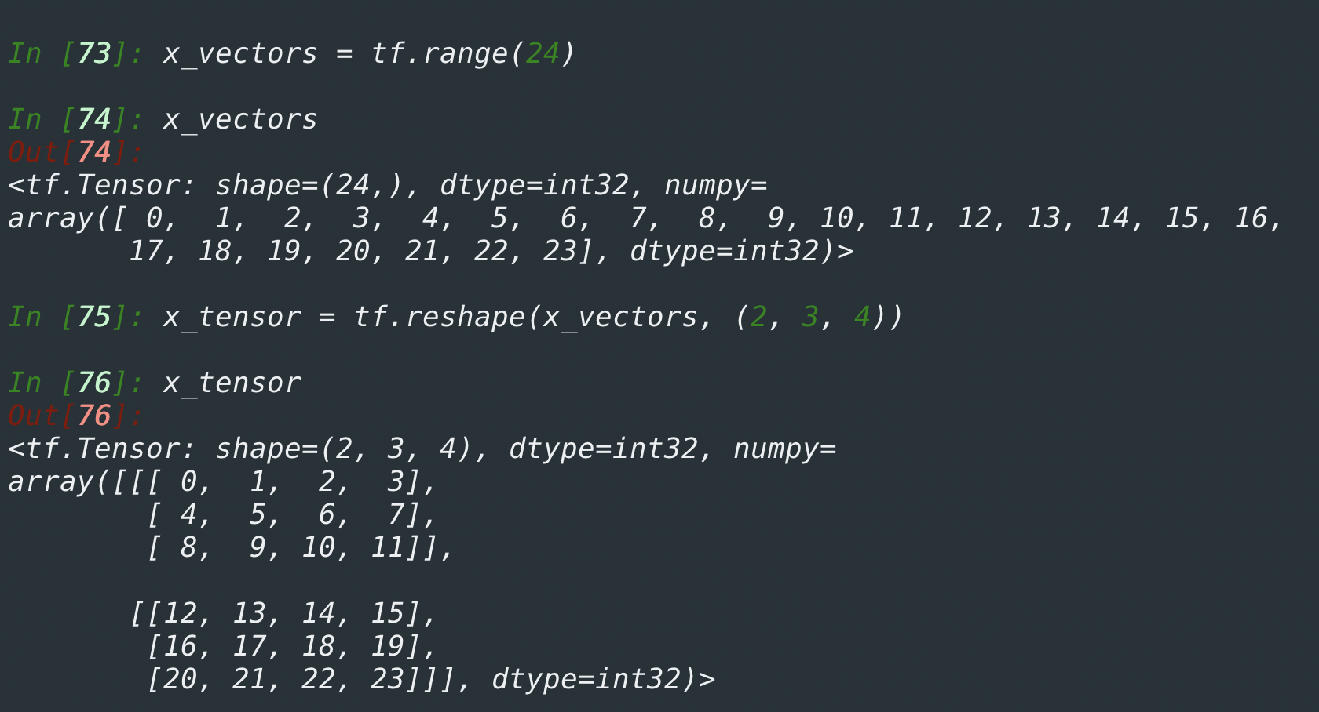
Mathematics for Machine & Deep Learning

Slide 8
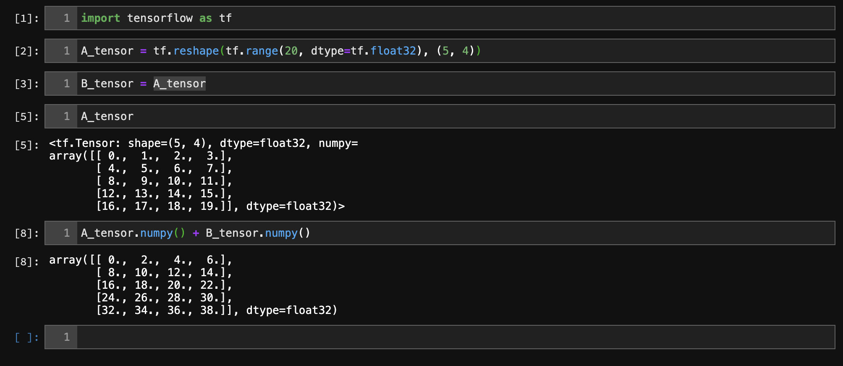
Mathematics for Machine & Deep Learning
Any two tensors with the same shape, the result of any binary element-wise operation will be a tensor of that same shape

Slide 9
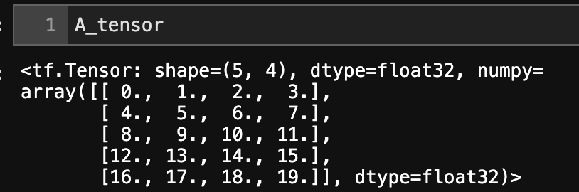
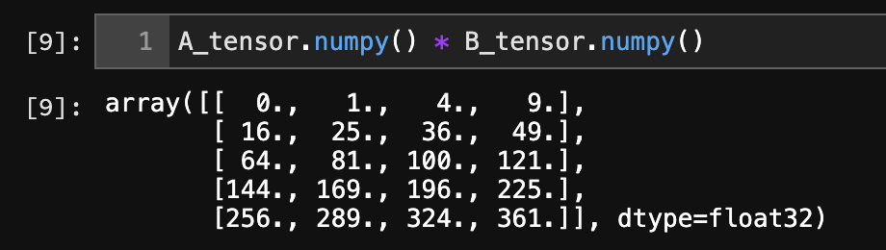
Mathematics for Machine & Deep Learning
Specifically, elementwise multiplication of two matrices is called their Hadamard product
Multiplying or adding a tensor by a scalar also does not change the shape of the tensor, where each element of the operand tensor will be added or multiplied by the scalar.

Slide 10
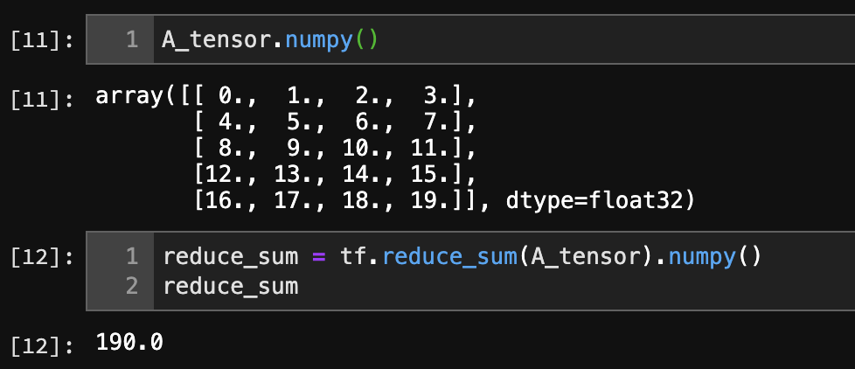
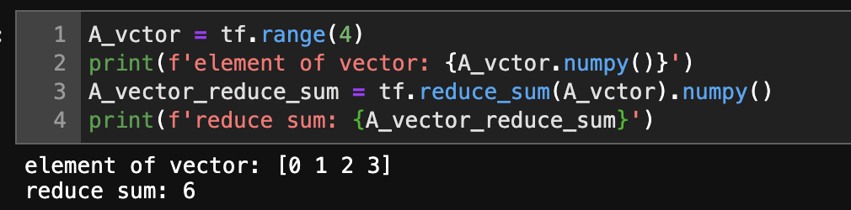
Mathematics for Machine & Deep Learning
Reduction: One useful operation that we can perform with arbitrary tensors is to calculate the sum of their elements. In mathematical notation, we express sums using the ∑ symbol. To express the sum of the elements in a vector 𝐱 of length 𝑑

Slide 11
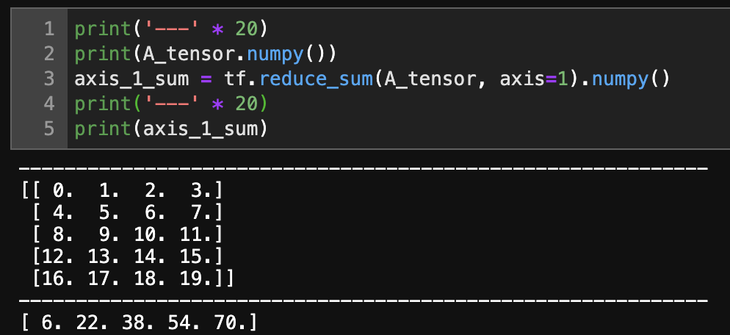
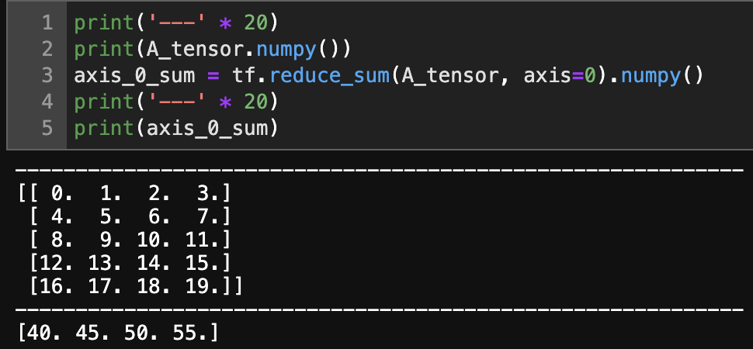
Mathematics for Machine & Deep Learning
Reduction: Specifying axis=1 will reduce the column dimension (axis 1) by summing up elements of all the columns. Thus, the dimension of axis 1 of the input is lost in the output shape.
Axis value: 1
Axis value: 0

Slide 12
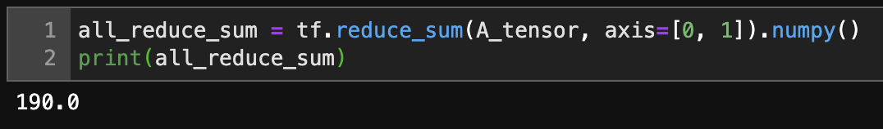
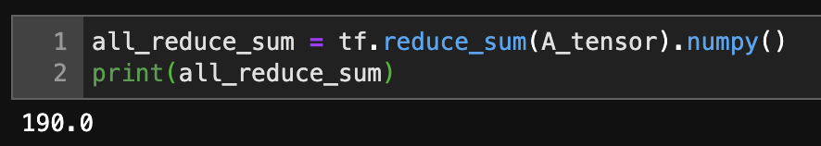
Mathematics for Machine & Deep Learning
Reducing a matrix along both rows and columns via summation is equivalent to summing up all the elements of the matrix.

Slide 13
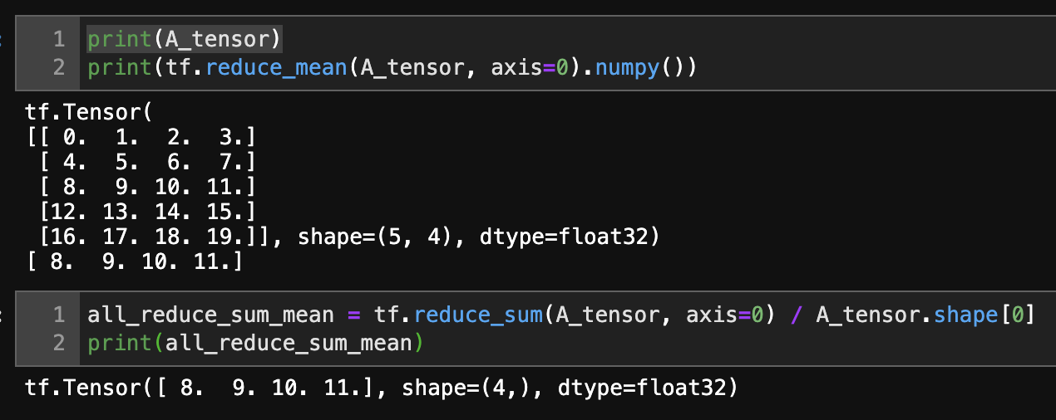
Mathematics for Machine & Deep Learning
Likewise, the function for calculating the mean can also reduce a tensor along the specified axes

Slide 14
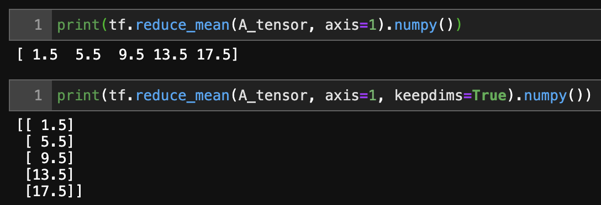
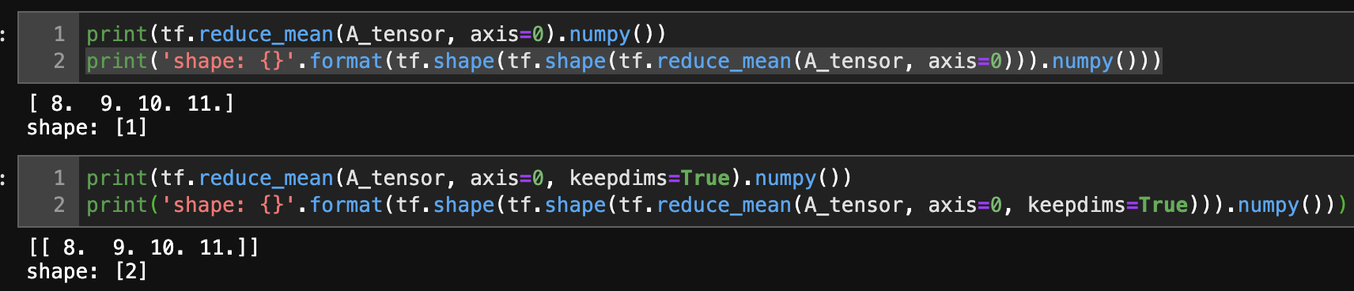
Mathematics for Machine & Deep Learning
It can be useful to keep the number of axes unchanged when invoking the function for calculating the sum or mean

Slide 15
Mathematics for Machine & Deep Learning
It can be useful to keep the number of axes unchanged when invoking the function for calculating the sum or mean

Slide 16
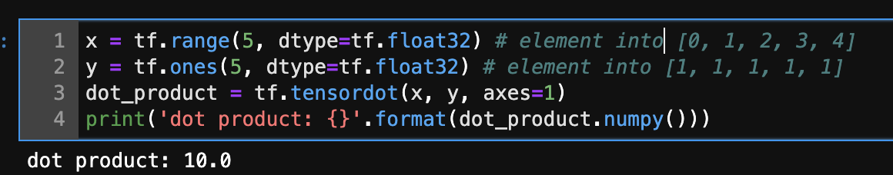
Mathematics for Machine & Deep Learning

Slide 17
Mathematics for Machine & Deep Learning
Summary
Scalars, vectors, matrices, and tensors are basic mathematical objects in linear algebra
Vectors generalize scalars, and matrices generalize vectors
Scalars, vectors, matrices, and tensors have zero, one, two, and an arbitrary number of axes, respectively

Slide 18
Mathematics for Machine & Deep Learning
Summary
A tensor can be reduced along the specified axes by sum and mean.
Elementwise multiplication of two matrices is called their Hadamard product. It is different from matrix multiplication
We can perform a variety of operations over scalars, vectors, matrices, and tensors

Slide 19
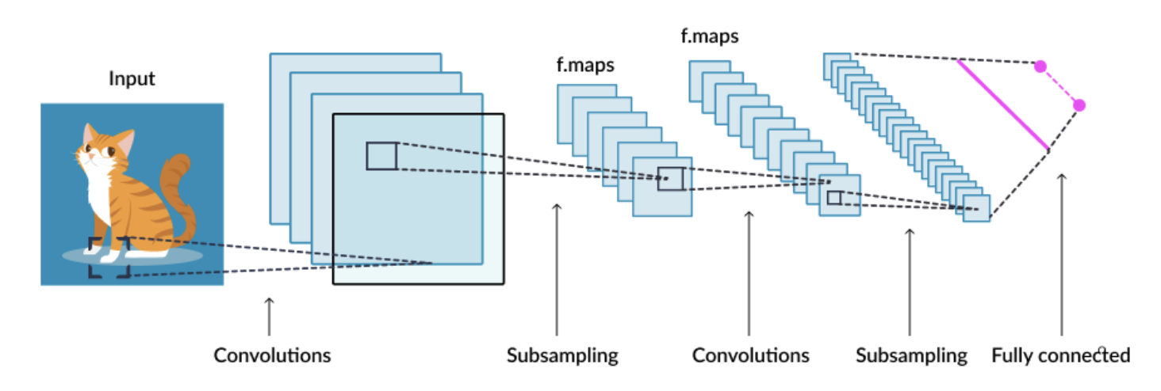
Linear Regression
Classification VS Regression
Classify input into categorical output

Slide 20
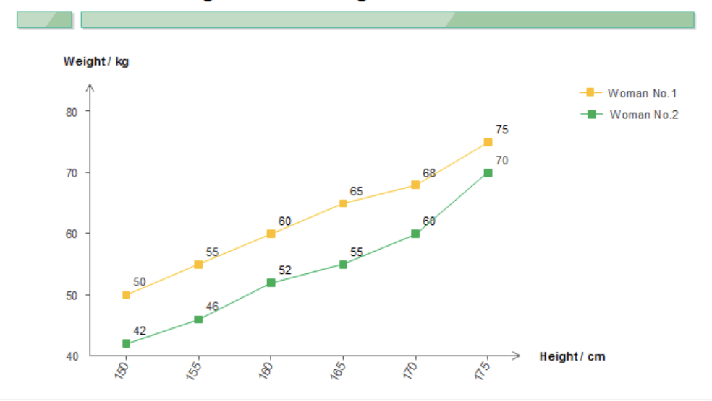
Linear Regression
Classification VS Regression
How tall is he if his weight is 80kg

Slide 21
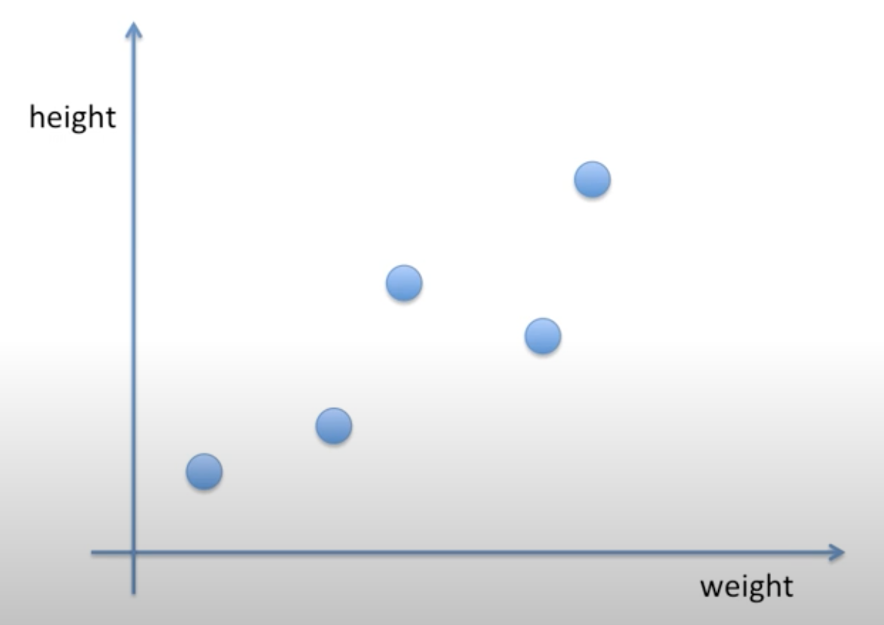
Linear Regression
Linear regression predicts output by fitting a linear equation y = ax + b to observed data

Slide 22
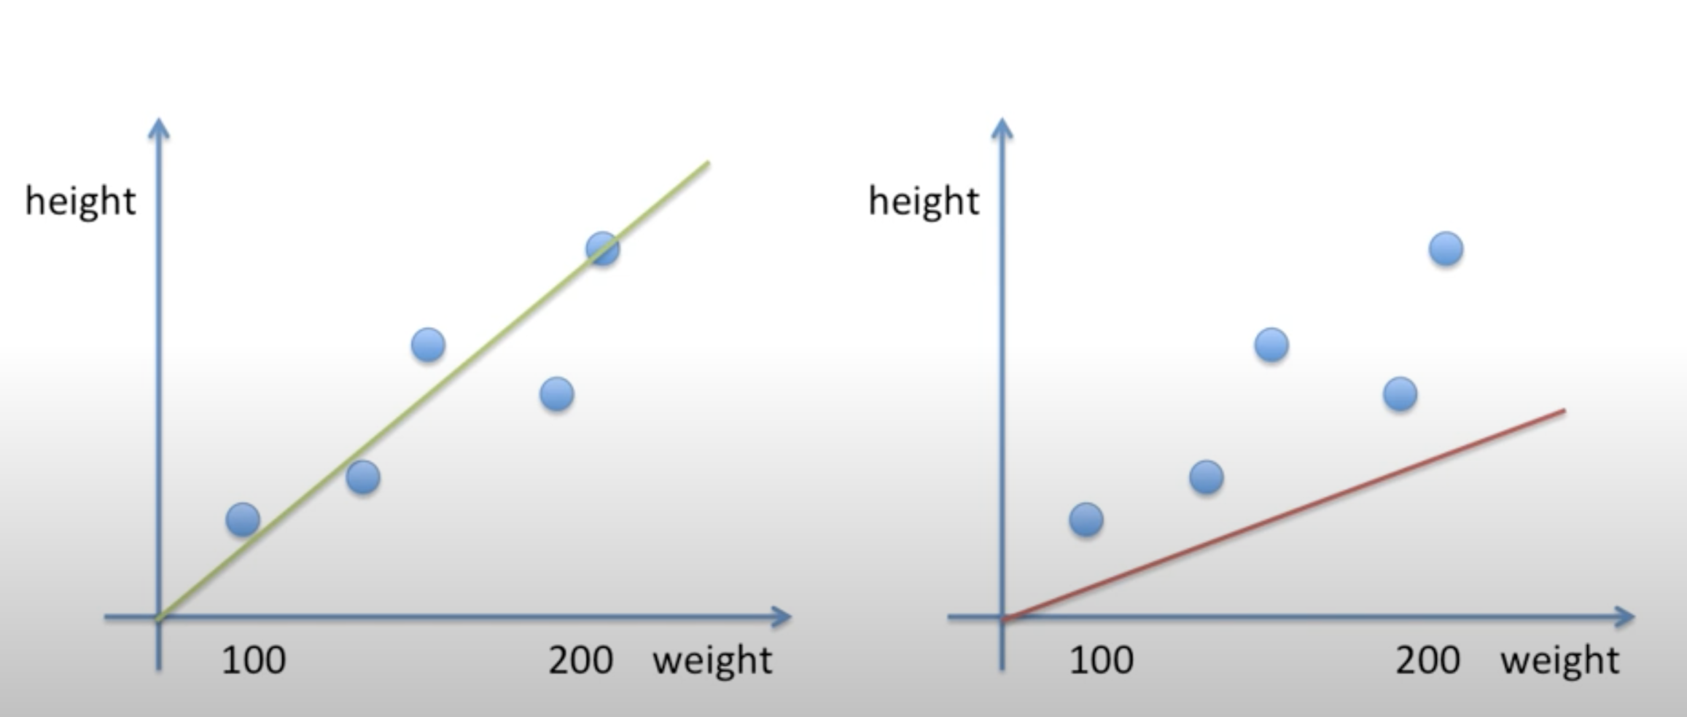
Linear Regression
Which line will predict more likely to true height

Slide 23
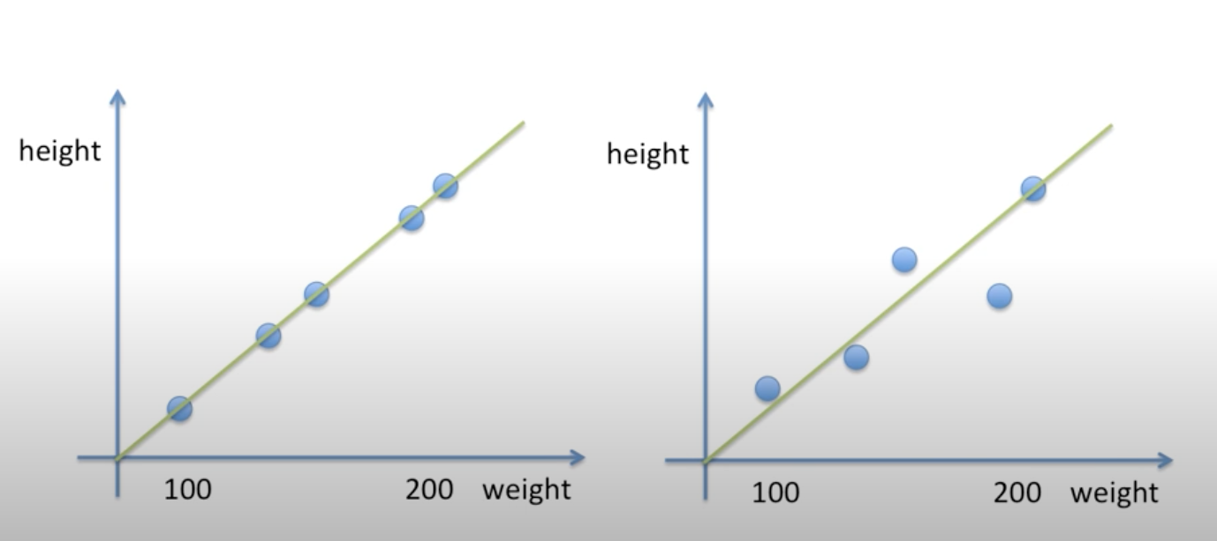
Linear Regression
Which line will predict more likely to true height?

Slide 24
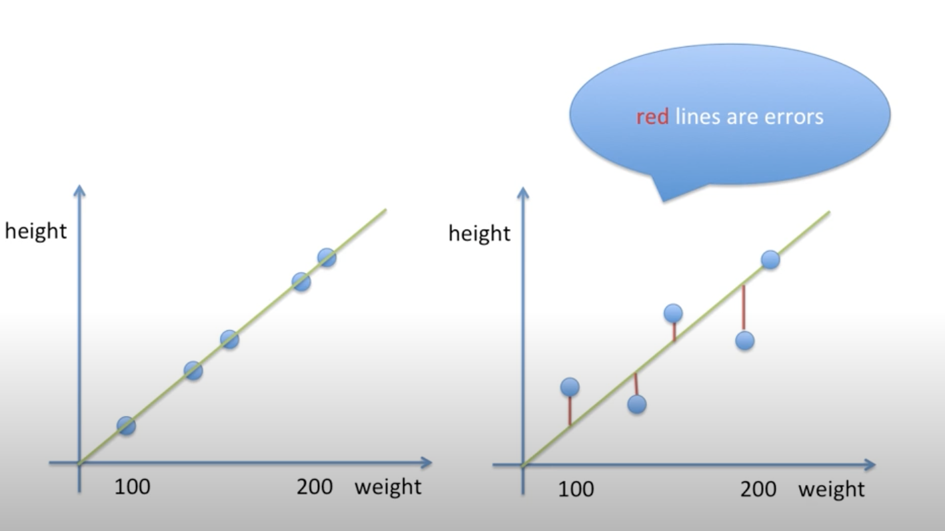
Linear Regression
Error – difference between prediction and real value

Slide 25
Linear Regression
Which line will predict more likely to true height

Slide 26
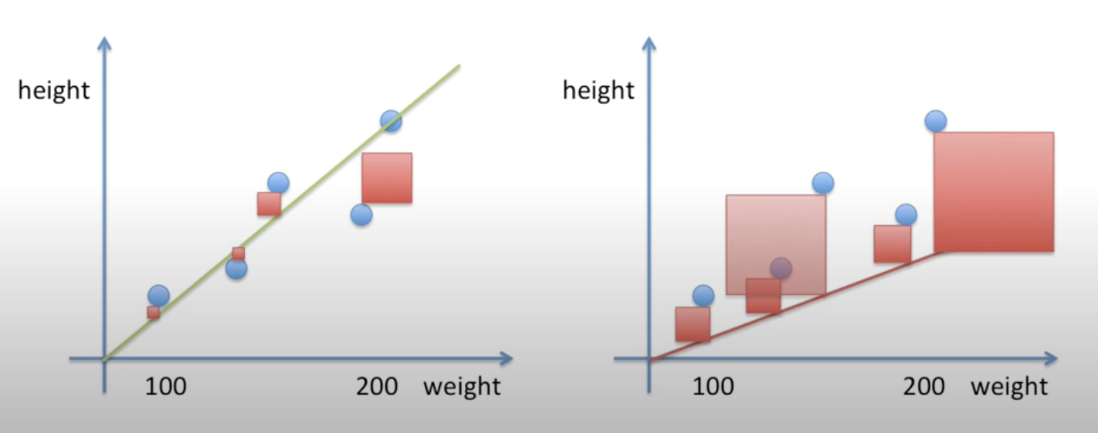
Linear Regression
Mean Square Error
Green line has less error, therefore prediction will be more likely to be true value height
Stochastic vs MLH

Slide 27
Linear Regression
How can you code to find best linear equation?

Slide 28
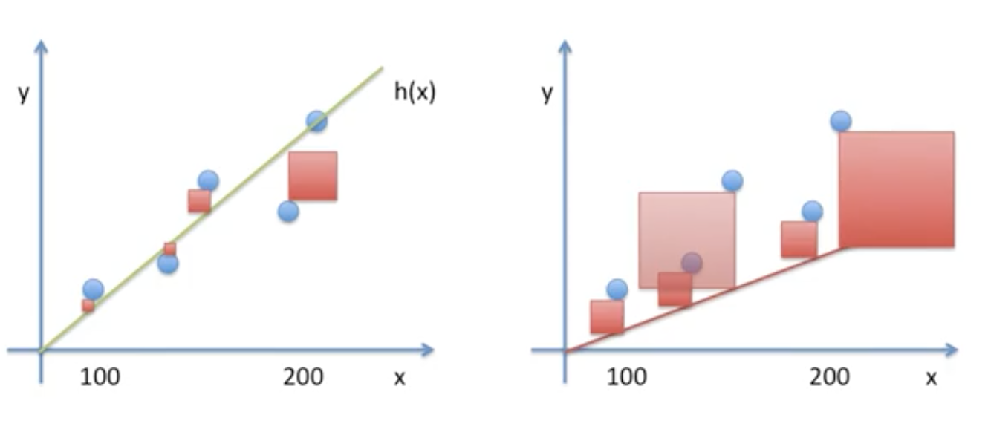
Linear Regression
Find Linear equation has Least Mean Square - LMS
How to find least mean square?
- Gradient Decent

Slide 29
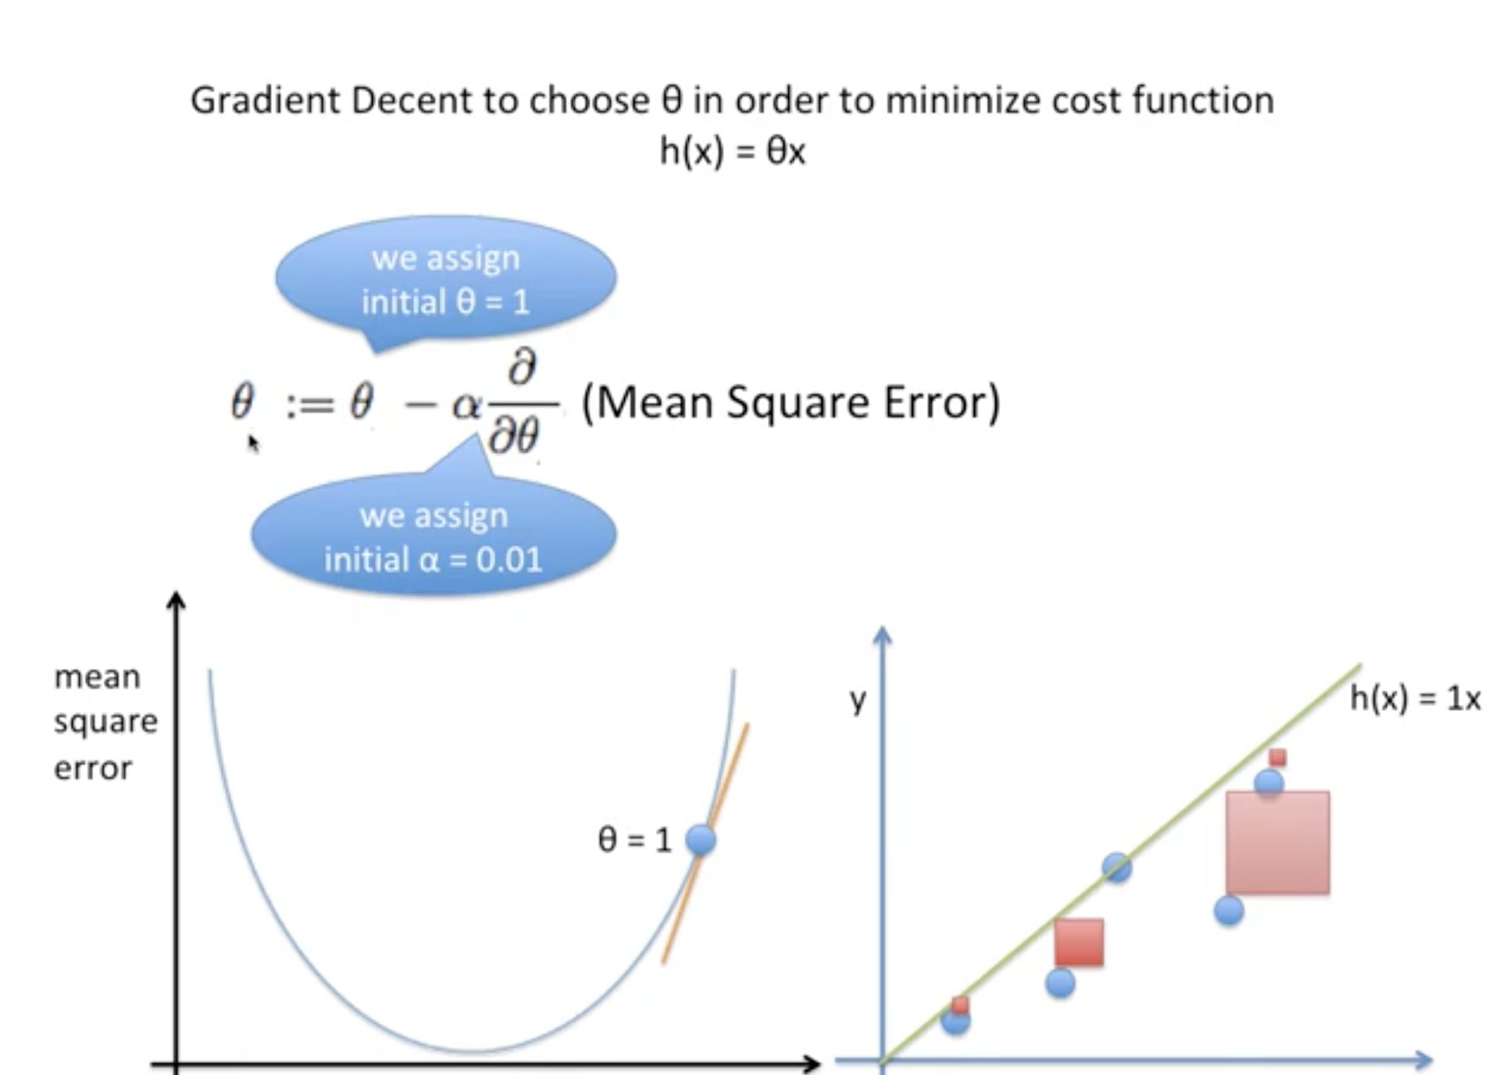
Linear Regression

Slide 30
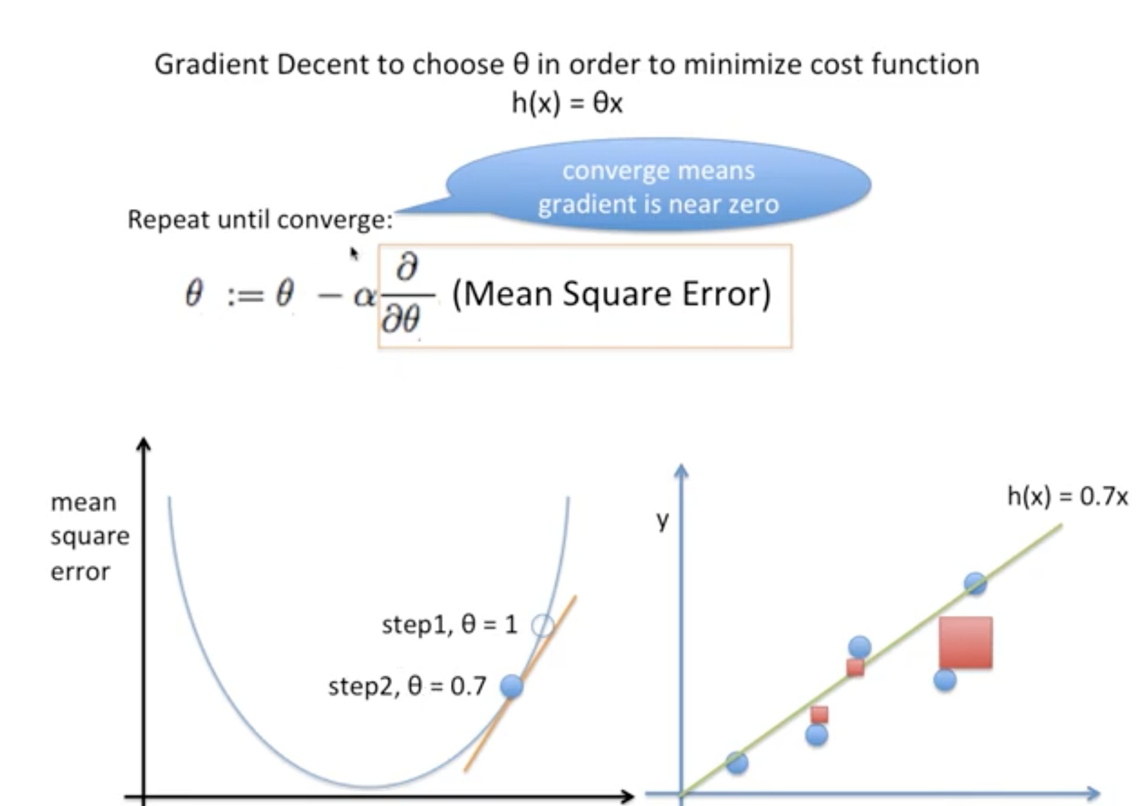
Linear Regression

Slide 31
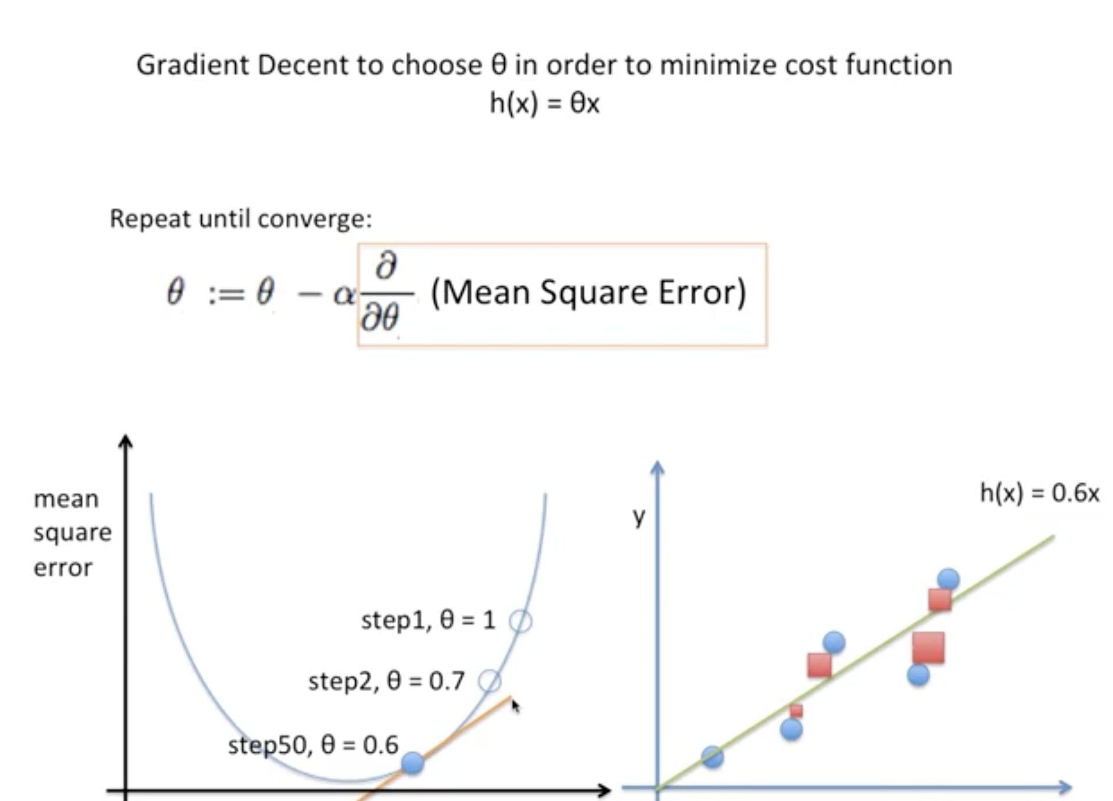
Linear Regression

Slide 32
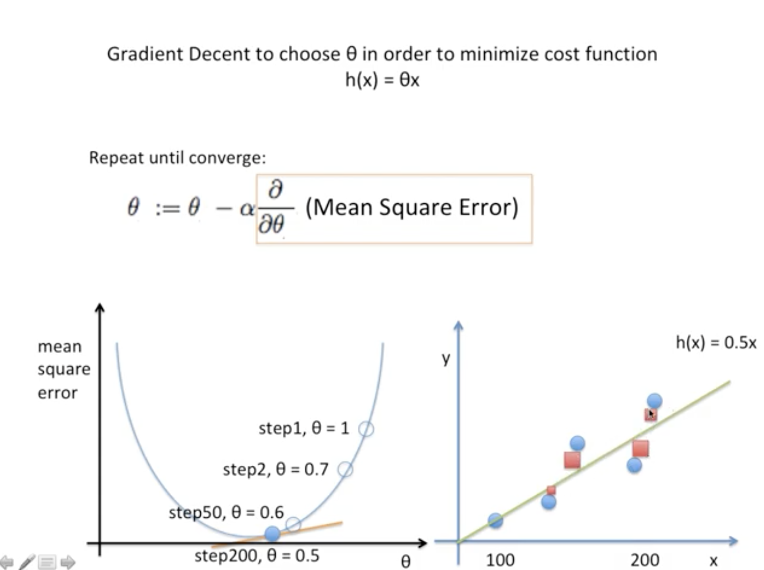
Linear Regression

Slide 33
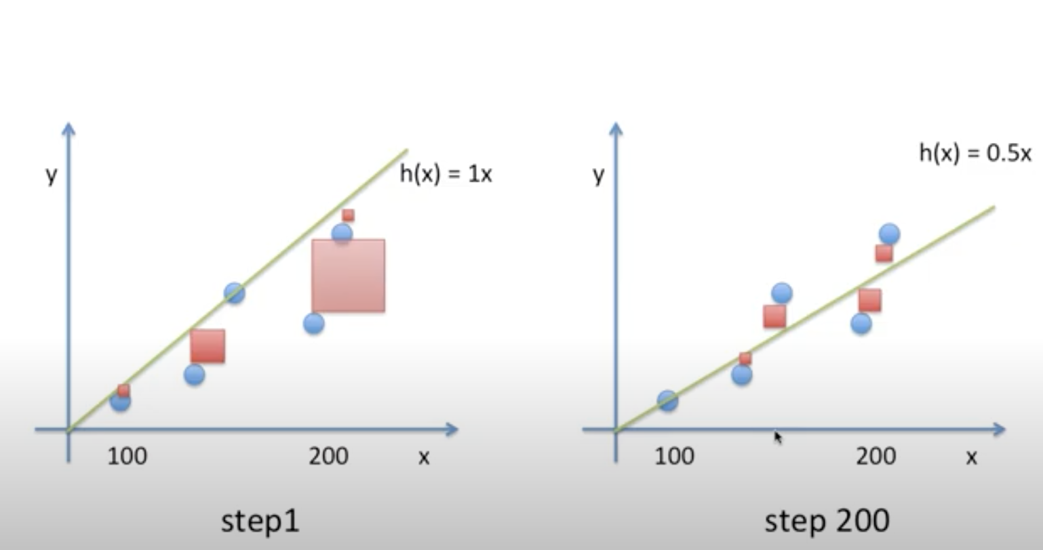
Linear Regression

Slide 34
Linear Regression
Summary
Key ingredients in a machine learning model are training data, a loss function, an optimization algorithm, and quite obviously, the model itself
Vectorizing makes everything better
Minimizing an objective function and performing maximum likelihood estimation can mean the same thing.
Linear regression models are neural networks, too.

